Slide 1
Amazon Product Sales Data Analysis Report
Shibbir Ahmed Arif
MS – Data Science
Montclair State University

Slide 2
Report Outline
Introduction & Objectives
Data Collection
Data Cleaning
Data Manipulation
Descriptive Statistics
Data Exploration
Insights and Visualization
Answer to the Analysis Questions
Limitations and Future Work

Slide 3
Introduction & Objectives
Purpose of Analysis:
What are the trends in product sales?
What are the factors that influence product sales?
Questions:
What are the most popular product categories?
What are the most popular product sub-categories?
What are the most popular products by ratings?
What are the most popular products by pricing strategy?
What are the top selling products?
What are the least selling products?

Slide 4
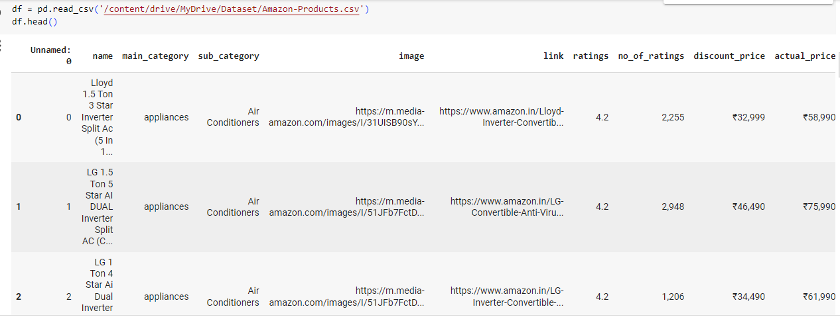
Data Collection
Data Source: https://www.kaggle.com/datasets/lokeshparab/amazon-products-dataset/
Dataset contains 551585 records and 10 fields

Slide 5
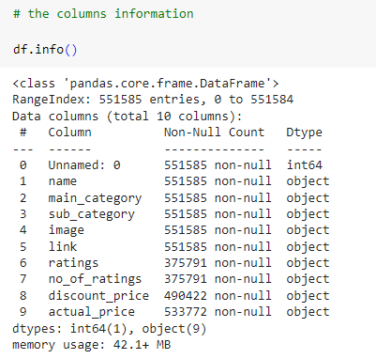
Data Information
The dataset is noisy
There are some non-numeric values
in the numeric data fields

Slide 6
Data Cleaning
Steps for cleaning:
Imported the required libraries into Google Collab Notebook
Load the dataset into the Python Environment
Removed 3 unwanted columns, several missing records, and duplicates
Got rid of the rupee sign in two fields, and lots of invalid entries
After cleaning, there was 321138 records, and 7 fields.
Challenges faced:
The dataset contained lots of duplicated records
The dataset has lots of records that contained invalid entries
Many invalid entries had to be removed using advanced techniques like regex

Slide 7
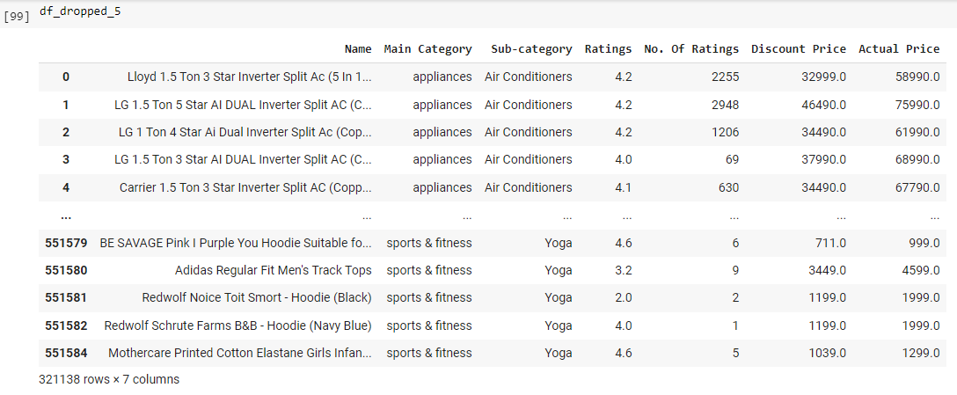
The Cleaned Dataset

Slide 8
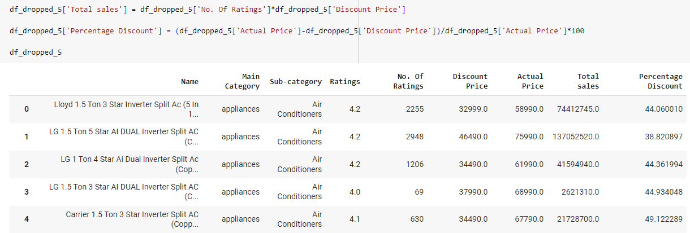
Data Manipulation
Data Wrangling
two new fields (Total Sales, and Percentage Discount) were added to enable better analysis

Slide 9
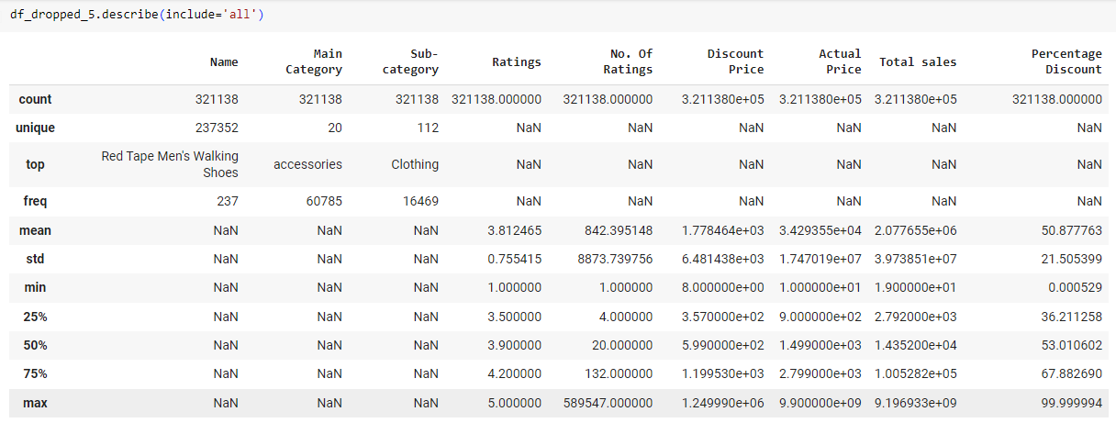
Descriptive Statistics
Summary Statistics

Slide 10
Data Exploration
Description of the fields:
'Name': Product names. 237352 unique values out of the 321138 records.
'Main Category': 20 main categories
'Sub-category': 112 sub-categories
'Ratings': Ranging from 1.0 ~ 5.0
'No. Of Ratings': Ranges from 1 ~ 589547. Taken as the volume of sales.
'Discount Price': Taken as the selling price. Ranging from 8 ~ 1249990
'Actual Price': The original price of the item. Ranging from 10 ~ 9900000000
'Total Sales': Field added as 'No. Of Ratings' x 'Discount Price’
'Percentage Discount': Field added as ('Actual Price' - 'Discount Price') / 'Actual Price' x 100%

Slide 11
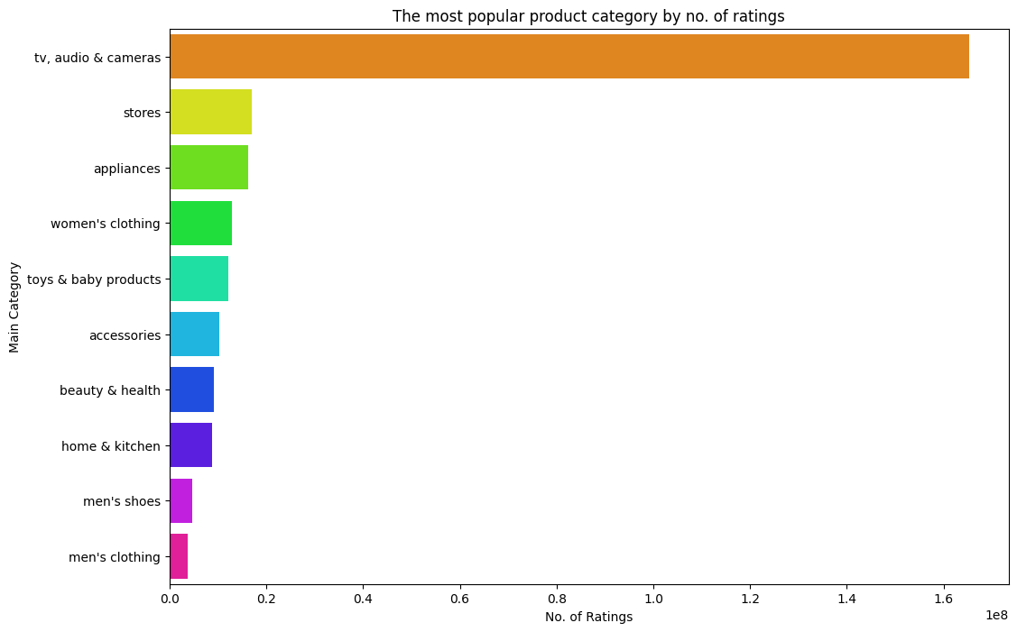
Insights and Visualization 1
The popular product categories that seemed to generate most sales and ratings were observed to be:
1) TV, audio & cameras
2) Stores
3) Appliances
4) Women's clothing
5) Toys & baby products
6) Accessories
7) Beauty & health
8) Home & kitchen

Slide 12
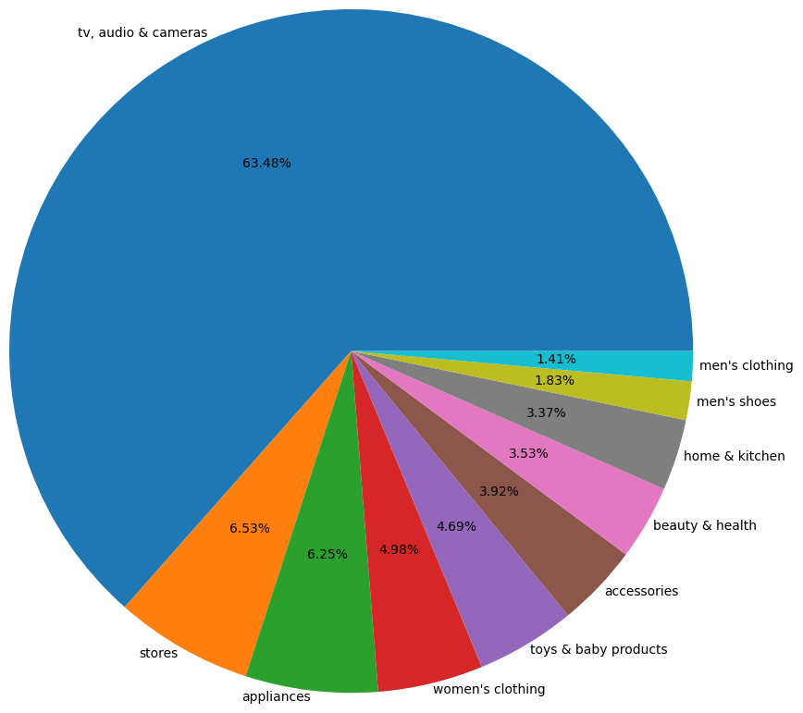
Insights and Visualization 2
Electronic/Equipment/Appliances take up
approx. 75% of the volume of sales

Slide 13
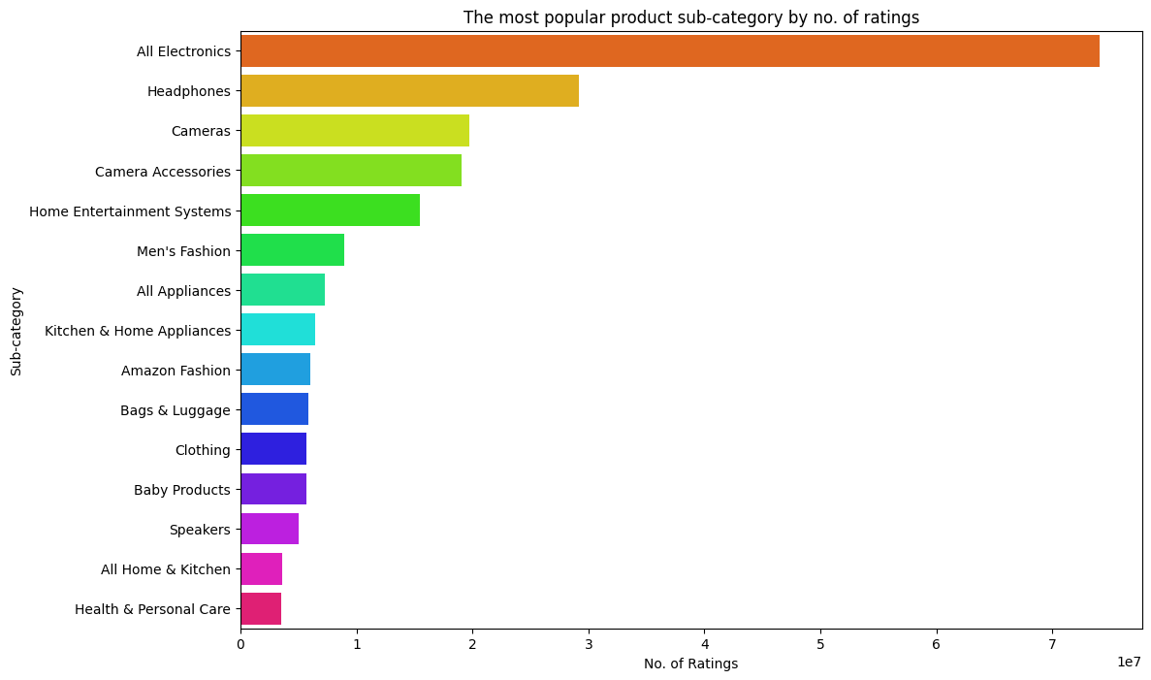
Insights and Visualization 3
The popular product Sub-categories that seemed to generate most sales and ratings were observed to be:
1) All Electronics
2) Headphones
3) Cameras
4) Camera Accessories
5) Home Entertainment Systems
6) Men's Fashion
7) All Appliances
8) Kitchen & Home Appliances
9) Amazon Fashion
10) Bags & Luggage

Slide 14
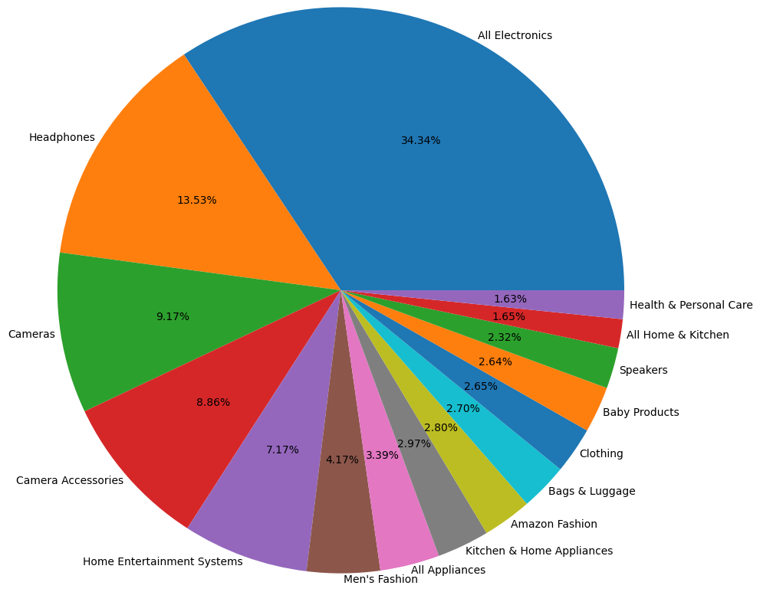
Insights and Visualization 4
As seen again, Electronic/Equipment/Appliances
take up approx. 75% of the volume of sales

Slide 15
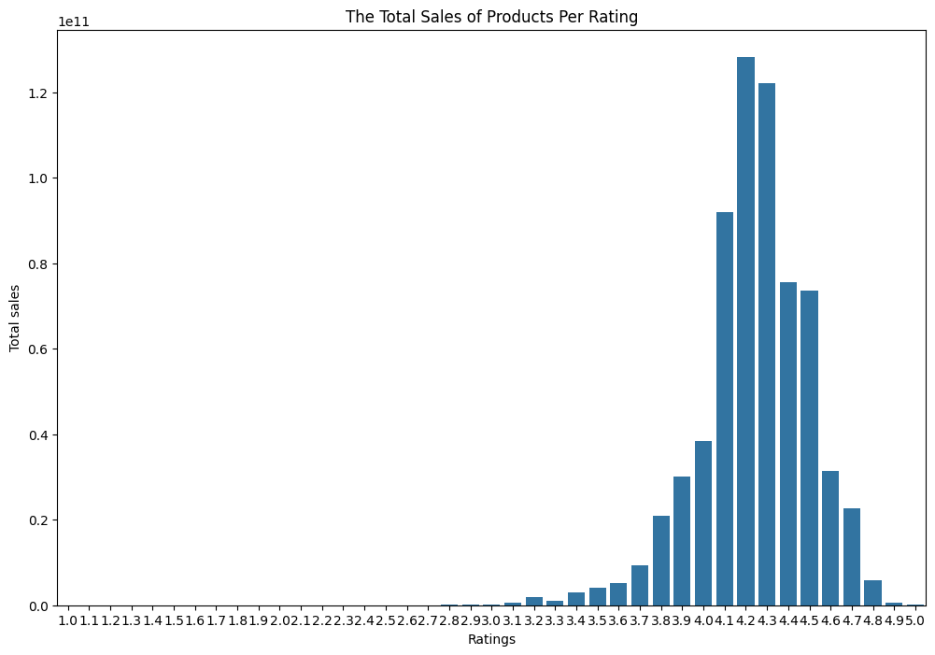
Insights and Visualization 5
The main Total Sales came from
products rated from 3.2 to 4.8

Slide 16
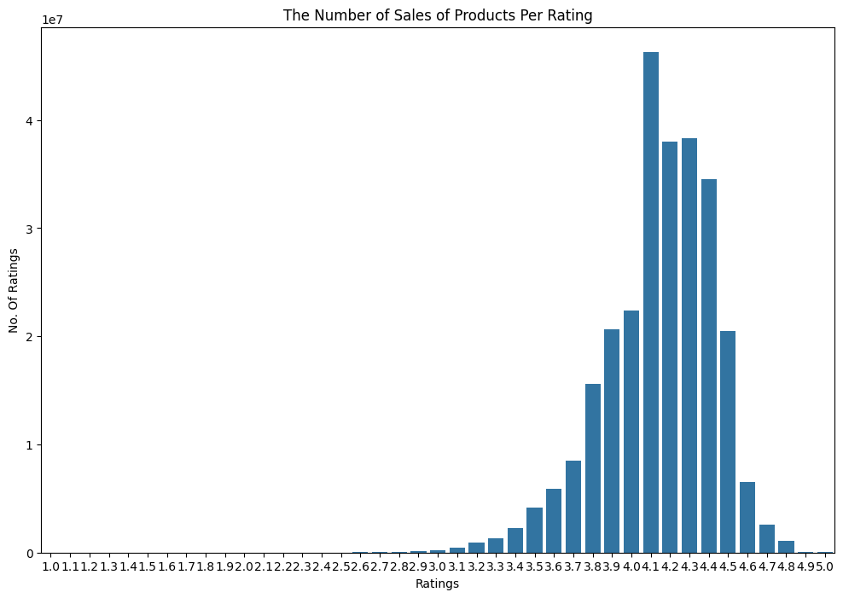
Insights and Visualization 6
The main volume of sales came from
products rated from 3.2 to 4.8

Slide 17
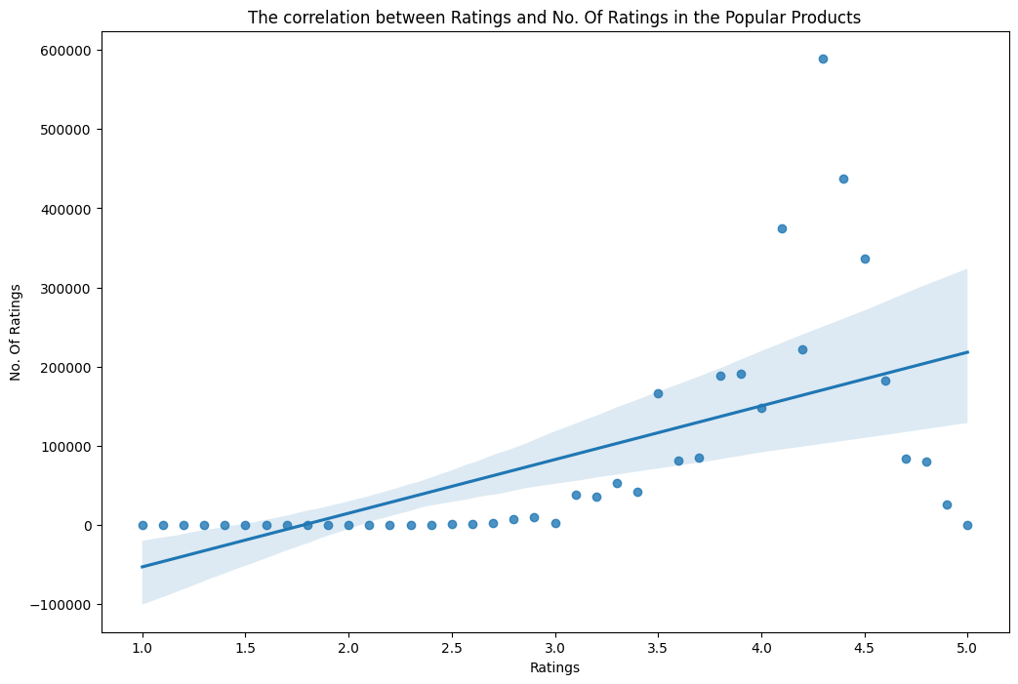
Insights and Visualization 7
There is a moderate correlation between
Ratings and Sales Volume.
Correlation Coefficient
= 0.476932 (Pearson)

Slide 18
Insights and Visualization 8
The 10 most popular products by ratings:
'SanDisk 400GB Class 10 MicroSD Card (SDSQUAR-400G-GN6MA) with Adapter'
'Redmi 164 cm (65 inches) 4K Ultra HD Android Smart LED TV X65 | L65M6-RA (Black)'
'Redmi 9A Sport (Carbon Black, 2GB RAM, 32GB Storage) | 2GHz Octa-core Helio G25 Processor | 5000 mAh Battery'
'Redmi 139 cm (55 inches) 4K Ultra HD Android Smart LED TV X55 | L55M6-RA (Black)'
'OnePlus Nord CE 2 Lite 5G (Blue Tide, 8GB RAM, 128GB Storage)'
'Apple iPhone 12 (128GB) - Green'
'Fitbit FB507RGPK Versa 2 Health & Fitness Smartwatch with Heart Rate, Music, Alexa Built-in, Sleep & Swim Tracking, Petal/...'
'Samsung Galaxy M12 (Black,6GB RAM, 128GB Storage) 6 Months Free Screen Replacement for Prime'
'TOZO T6 True Wireless Earbuds Bluetooth Headphones Touch Control with Wireless Charging Case IPX8 Waterproof Stereo Earpho...'
'MI 138.8 cm (55 inches) 5X Series 4K Ultra HD LED Smart Android TV L55M6-ES (Grey)'

Slide 19
Insights and Visualization 9
The 10 most popular product by discount pricing strategy are:
'SanDisk 256GB Class 10 MicroSD Card with Adapter (SDSQUAR-256G-GN6MA)'
'SanDisk 512GB Ultra MicroSDXC UHS-I Memory Card - 100MB/s, C10, U1, Full HD, A1, Micro SD Card - SDSQUAR-512G-GN6MN'
'Amazon Basics High-Speed HDMI Cable, 6 Feet (2-Pack),Black'
'Amazon Basics High-Speed HDMI Cable - 10 Feet (2-Pack) -Latest Standard for Xbox, PlayStation, Television, Personal Comput...'
'boAt BassHeads 100 Delhi Capitals Edition Wired in Ear Earphones with Super Extra Bass, with mic'
'boAt BassHeads 100 in-Ear Wired Headphones with Mic (Black)'
'AmazonBasics AAA Performance Alkaline Non-rechargeable Batteries (36 Count) - Appearance May Vary'
'Pigeon Polypropylene Mini Handy and Compact Chopper with 3 Blades for Effortlessly Chopping Vegetables and Fruits for Your'
'Huggies Complete Comfort Wonder Pants Large (L) Size Baby Diaper Pants Sumo Pack, 192 count, with 5 in 1 Comfort'
'Huggies Wonder Pants Small (S) Size Baby Diaper Pants, 20 count, with Bubble Bed Technology for comfort'

Slide 20
Insights and Visualization 10
Top 10 top selling products are:
The "SanDisk MicroSDXC Memory Card" products
The "Amazon Basics High-Speed HDMI Cable" products
The "boAt BassHeads 100 in-Ear Wired Headphones" products
The "AmazonBasics Performance Alkaline Non-rechargeable Batteries" products
The "Pigeon Polypropylene Mini Handy and Compact Chopper with 3 Blades" product
The "Redmi Note 10S" products
The "Huggies Wonder Pants, Monthly Box Pack Diapers" products
The "SanDisk Extreme SD UHS I 32GB Card" products
The "TOZO T6 True Wireless Earbuds Bluetooth Headphones" products
The "JBL C100SI Wired in Ear Headphones with Mic" products

Slide 21
Insights and Visualization 11
The 10 least selling products are:
'SOOTRA BRANDED carbon film resistor 1/4 watt 4 Band Tolerance 5% - Pack of 20pcs (10K Ohms)'
'10K ohm 1/4 Meenakari Radha Krishna Rakshabandhan Alloy Rakhi Bracelet With Multicolour Crystal StoneWatt Resistor 1% Tolerance - 10 Pieces Pack'
'Okos Gold Plated Blue and Green s...'
'SBWC Stylish Slim Lice Narrow Comb Fine Tooth Dust Lice Clean Remove Plastic Lice Hair Combs Perfect For Lice Nits Eggs Bu...'
'Moti Chain Gold Plated Beautiful American Diamond Heart Shape Necklace Golden Chain Pendant for Women and Girls'
'Kavi The Poetry-Art Project Kavi Cork Copper Wire led String Lights for Any Bottle, 2M/7.2FT Battery Powered, Ideal for Ga...'
'3386P- 2K Ohm 0.5W-Through Hole Trimmer Potentiometer - Pack of 2'
'MENTER Arm Sleeves Men & Women Sunlight Protection Protection from Dust, Pollution, Sunburn, UV Protection - Suitable for,...'
'Chetran’s Herbal Tofu 200G | Masala Flavor | Fresh Paneer Alternative | High Protein'
'Shelfkey.com ALUMINIUM ELECTROLYTIC CAPACITOR 1uF 63V SK-1uF/63V (B-356G)

Slide 22
Answer to the Analysis Questions
It was seen that one important trend in product sales is that the buyers tend to buy products from the SAME brand as a top-selling product.
Buyers also tend to buy from well-rated products in categories, as well as products that have higher number of ratings (as seen in the correlation data)
Important factors affecting product sales are:
a) Well-established product categories such as Electronics, Appliances, and Clothing seem to attract most sales,
b) Discount doesn't seem to encourage sales. In fact it was observed that well discounted products have lower sales (as seen in the correlation coefficient data),
c) Price of item (actual price) has no effect on volume of sales.

Slide 23
Limitations and Future Work
The dataset contained a lot of missing values, invalid entries, and inconsistent data that might have an effect on analysis
More fields like Monthly data, etc. might be needed to help obtain trends in product sales with respect to time

Slide 24
Thank You!

